Slide 1

Creational Design patterns

Slide 2
Introduction
Creational design patterns are concerned with the way of creating objects.
These design patterns are used when a decision must be made at the time of instantiation of a class (i.e creating an object of a class).
There are following 5 types of creational design patterns
Factory Method Pattern
Abstract Factory Pattern
Singleton Pattern
Prototype Pattern
Builder Pattern

Slide 3
Factory Pattern
A Factory Pattern says that just define an interface or abstract class for creating an object but let the subclasses decide which class to instantiate.
In other words, subclasses are responsible to create the instance of the class.
Usage :
When a class doesn't know what sub-classes will be required to create
When a class wants that its sub-classes specify the objects to be created.

Slide 4
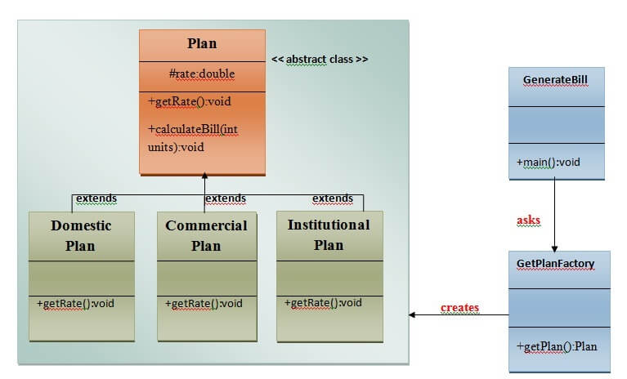
UML Diagram :

Slide 5
abstract class Plan{
protected double rate;
abstract void getRate();
public void calculateBill(int units){
System.out.println(units*rate);
}
}
class DomesticPlan extends Plan
{
public void getRate(){
rate=3.50;
}
}
class CommercialPlan extends Plan{
public void getRate(){
rate=7.50;
}
}
class InstitutionalPlan extends Plan{
public void getRate(){
rate=5.50;
}
}
class GetPlanFactory{
public Plan getPlan(String planType){
if(planType == null){
return null;
}
if(planType.equalsIgnoreCase("DOMESTICPLAN")) {
return new DomesticPlan();
}
else if(planType.equalsIgnoreCase("COMMERCIALPLAN")){
return new CommercialPlan();
}
else if(planType.equalsIgnoreCase("INSTITUTIONALPLAN")) {
return new InstitutionalPlan();
}
return null;
}
}

Slide 6
class FactoryPattern
{
public static void main(String args[])throws IOException
{
GetPlanFactory planFactory = new GetPlanFactory();
System.out.print("Enter the name of plan for which the bill will be generated: ");
BufferedReader br=new BufferedReader(new InputStreamReader(System.in));
String planName=br.readLine();
System.out.print("Enter the number of units for bill will be calculated: ");
int units=Integer.parseInt(br.readLine());
Plan p = planFactory.getPlan(planName);
System.out.print("Bill amount for "+planName+" of "+units+" units is: ");
p.getRate();
p.calculateBill(units);
}
}

Slide 7
Abstract Factory Pattern
/
Abstract Factory Pattern says that just define an interface or abstract class for creating families of related (or dependent) objects but without specifying their concrete subclasses.
That means Abstract Factory lets a class returns a factory of classes.
So, this is the reason that Abstract Factory Pattern is one level higher than the Factory Pattern.

Slide 8
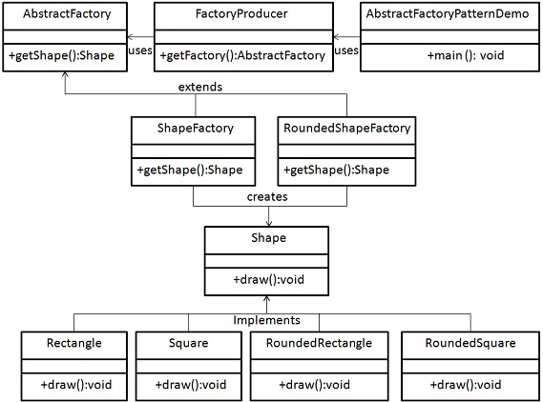

Slide 9
public interface Shape {
void draw();
}
public class RoundedRectangle implements Shape {
public void draw()
{
System.out.println("Inside RoundedRectangle::draw() method.");
}
}
public class RoundedSquare implements Shape {
public void draw() {
System.out.println("Inside RoundedSquare::draw() method.");
}
}
public class Rectangle implements Shape {
public void draw() {
System.out.println("Inside Rectangle::draw() method.");
}
}

Slide 10
public class Square implements Shape {
public void draw() {
System.out.println("Inside Square::draw() method.");
}
}
public abstract class AbstractFactory {
abstract Shape getShape(String shapeType) ;
}
public class ShapeFactory extends AbstractFactory {
public Shape getShape(String shapeType){
if(shapeType.equalsIgnoreCase("RECTANGLE")){
return new Rectangle();
}else if(shapeType.equalsIgnoreCase("SQUARE")){
return new Square();
}
return null;
}
}

Slide 11
public class RoundedShapeFactory extends AbstractFactory {
public Shape getShape(String shapeType){
if(shapeType.equalsIgnoreCase("RECTANGLE")){
return new RoundedRectangle();
}else if(shapeType.equalsIgnoreCase("SQUARE")){
return new RoundedSquare();
}
return null;
}
}
public class FactoryProducer {
public static AbstractFactory getFactory(boolean rounded){
if(rounded){
return new RoundedShapeFactory();
}else{
return new ShapeFactory();
}
}
}

Slide 12
public class AbstractFactoryPatternDemo {
public static void main(String[] args) {
AbstractFactory shapeFactory = FactoryProducer.getFactory(false);
Shape shape1 = shapeFactory.getShape("RECTANGLE");
shape1.draw();
Shape shape2 = shapeFactory.getShape("SQUARE");
shape2.draw();
AbstractFactory shapeFactory1 = FactoryProducer.getFactory(true);
Shape shape3 = shapeFactory1.getShape("RECTANGLE");
shape3.draw();
Shape shape4 = shapeFactory1.getShape("SQUARE");
shape4.draw();
}
}

Slide 13
Singleton Design Pattern
Singleton Pattern says that just “ define a class that has only one instance and provides a global point of access to it".
In other words, a class must ensure that only single instance should be created and single object can be used by all other classes.

Slide 14
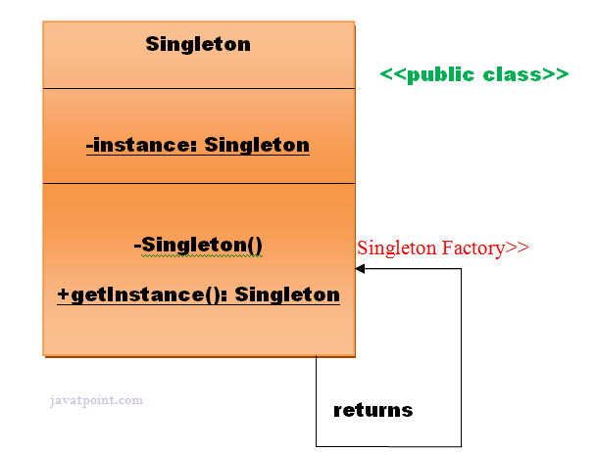

Slide 15
class SingletonExample {
public static void main(String args[])
{
Singleton x = Singleton.createInstance();
Singleton y = Singleton.createInstance();
System.out.println("Hashcode of x is "+ x.hashCode());
System.out.println("Hashcode of y is "+ y.hashCode());
if (x == y) {
System.out.println("Same");
}
else {
System.out.println("Different");
}
}
}
class Singleton {
private static Singleton single_instance = null;
public String s;
private Singleton()
{
s = "Hello I am a string part of Singleton class";
}
public static Singleton createInstance()
{
if (single_instance == null)
single_instance = new Singleton();
return single_instance;
}
}

Slide 16
Prototype Design Pattern
Prototype Pattern says that cloning of an existing object instead of creating new one and can also be customized as per the requirement.
This pattern should be followed, if the cost of creating a new object is expensive.

Slide 17
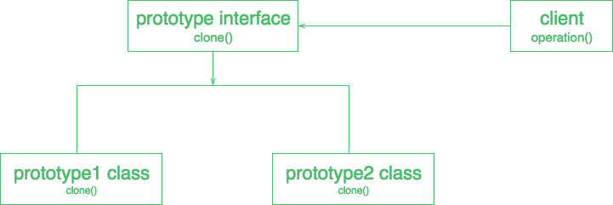

Slide 18
public class Vegetable
{
private double vprice;
private String vname;
Fruit(double vPrice, String vName)
{
vprice = vPrice;
vname = vName;
}
//creating a copy constructor
Vegetable(Vegetable vegetable)
{
System.out.println("\nAfter invoking the Copy Constructor:\n");
vprice = vegetable.fprice;
vname = vegetable.fname;
}
//creating a method that returns the price of the fruit
double showPrice()
{
return vprice;
}

Slide 19
//creating a method that returns the name of the fruit
String showName()
{
return vname;
}
public static void main(String args[])
{
Vegetable v1 = new Vegetable(399, "Carrot");
System.out.println("Name of the first vegetable: "+ v1.showName());
System.out.println("Price of the first vegetable: "+ v1.showPrice());
//passing the parameters to the copy constructor
Vegetable v2 = new Vegetable(v1);
System.out.println("Name of the second vegetable: "+ v2.showName());
System.out.println("Price of the second vegetable: "+ v2.showPrice());
System.out.println("Hashcode of x is "+ v1.hashCode());
System.out.println("Hashcode of y is "+ v2.hashCode());
if (v1 == v2) {
System.out.println("Same");
}
else {
System.out.println("Different");
}
}
}

Slide 20

Builder Design Pattern
Builder Pattern says that "construct a complex object from simple objects using step-by-step approach“.
It is mostly used when object can't be created in single step

Slide 21
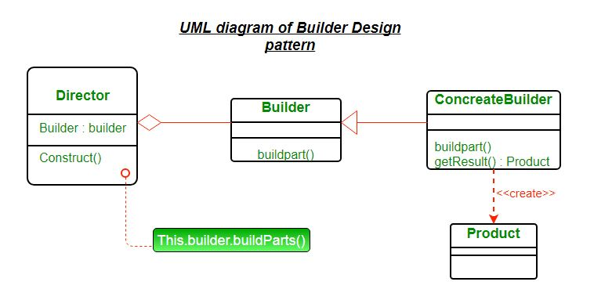

Slide 22
Product – The product class defines the type of the complex object that is to be generated by the builder pattern.
Builder – This abstract base class defines all of the steps that must be taken in order to correctly create a product. The builder class is often replaced with a simple interface.
Concrete Builder – There may be any number of concrete builder classes inheriting from Builder. These classes contain the functionality to create a particular complex product.
Director – The director-class controls the algorithm that generates the final product object.

